Slide 1
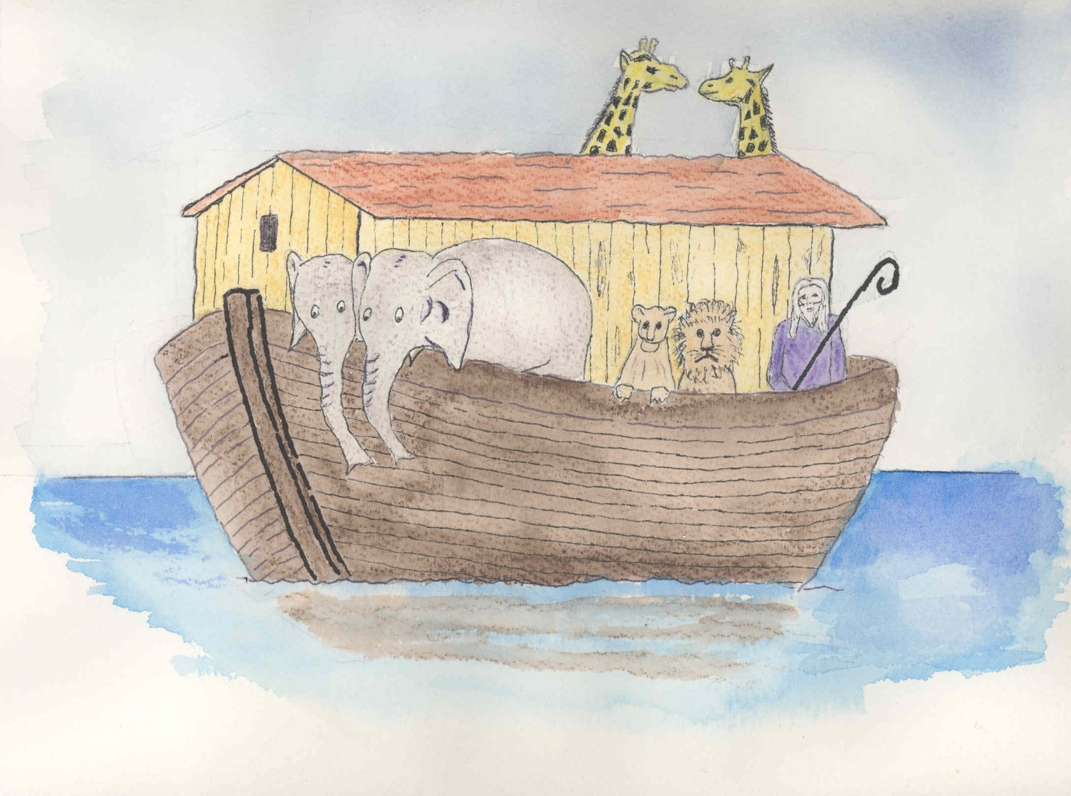
Joan of Ark Pet Sitting
“I’m Noah’s Nannie”

